Slide 1

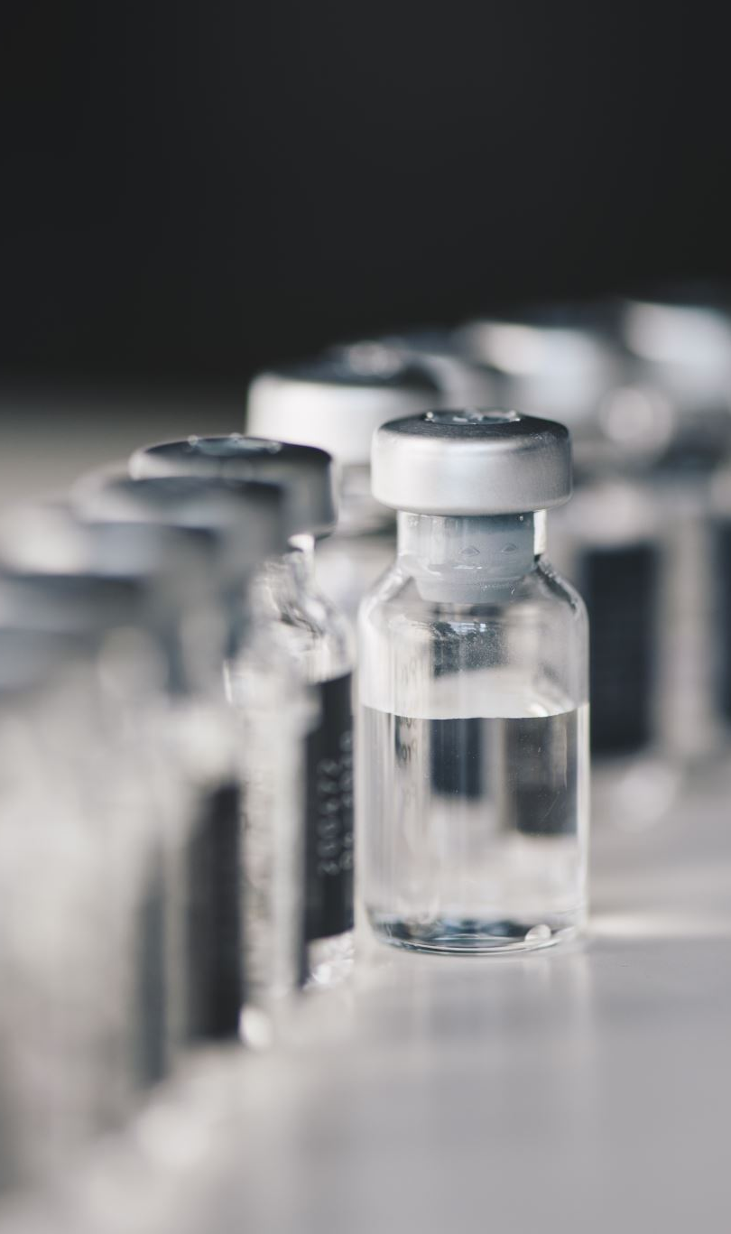
The Covid-19 Vaccine Project and Lean
One More Thing Presentation
Jayke Sudana

Slide 2
Covid-19 Vaccination Timeline
December 12, 2019
First COVID-19 case in Wuhan, China.
January 20, 2020
First COVID-19 case in U.S.
April 20, 2020
Operation Warp Speed is launched.
June 14, 2020
BLM protests across the country.
December 11, 2020
First vaccine by Pfizer-BioNTech.
December 20, 2020
EUA for 2nd vaccine, Moderna.
February 20, 2021
FDA issues EUA for 3rd vaccine, J&J.
March 13, 2021
100 million vaccines given in the U.S.
April 21, 2021
200 million vaccines given in U.S.
Source: https://www.cdc.gov/museum/timeline/covid19.html
Notes:
Rapid, intense, global response and activity to COVID-19 pandemic.
A clinical, operational, and scientific endeavor that represents one of biggest collaborative projects in humankind.
Let’s back track! In late December 2019, the first covid cases appeared; the first U.S. confirmed case in the U.S. was confirmed late January, 2020; The U.S. government announces the launch of Operation Warp Speed, a highly funded project with a wide variety of collaborators all trying to look for a covid vaccine or cure.
By mid and late December of 2020, Pfizer and Moderna “drop” their vaccines.
By mid March of 2021, there were 100 million vaccines administered in the U.S. alone. One month later, 200 million vaccines

Slide 3
Outlining Questions
What lean principles helped streamline production of millions of vaccines?
How was lean used to create a vaccine in <1 year?
Notes:
The race to the vaccine was a tremendous effort, so this presentation will look at how the entire process was microwaved into under one year using lean principles.
The volume of vaccines that were made are on a never-before-seen-scale, so we will look at how lean was conducive to producing and distributing millions of vaccines to people

Slide 4
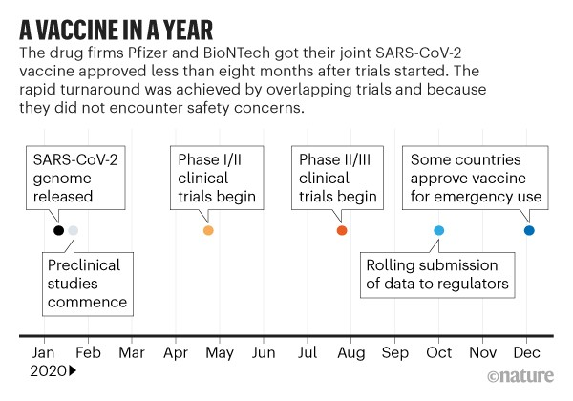

Vaccine Development
Build on Existing Knowledge
Trial & Info Standardization
Parallel Development (One-Piece flow)
Notes:
The need was to speed through vaccine developmental stages. These processes come together to help build a vaccine (center).
Build on existing knowledge: Moderna had a vaccine ready to put into clinical trials 2 days after the SARS-CoV-2 genome was released. Other companies quickly followed.
mRNA vaccines were in development long before Covid-19 and were developed against diseases like MERS in 2012 and SARS-1 in 2002.
Coronaviruses are heavily studied.
We did not have to create anything from scratch.
There were tons of stakeholders involved and the process could have become messy if different companies shared their results differently, so a harmonized method of testing was made
Companies could look at results from other companies
Government could read company results more easily and approve them quicker
Saves on any hassle or wasted time added from confusion
They used parallel development for clinical trials, so instead of starting with trial 1 then moving to trail 2 then to trial 3 sequentially, they planned and prepared trial 2 and 3 while trial 1 was being performed.
When trial 1 was complete they could adjust a few things and immediately start trial 2.
A HUGE time saver
The upstream trial could “pull” from the downstream trial upon its completion

Slide 5
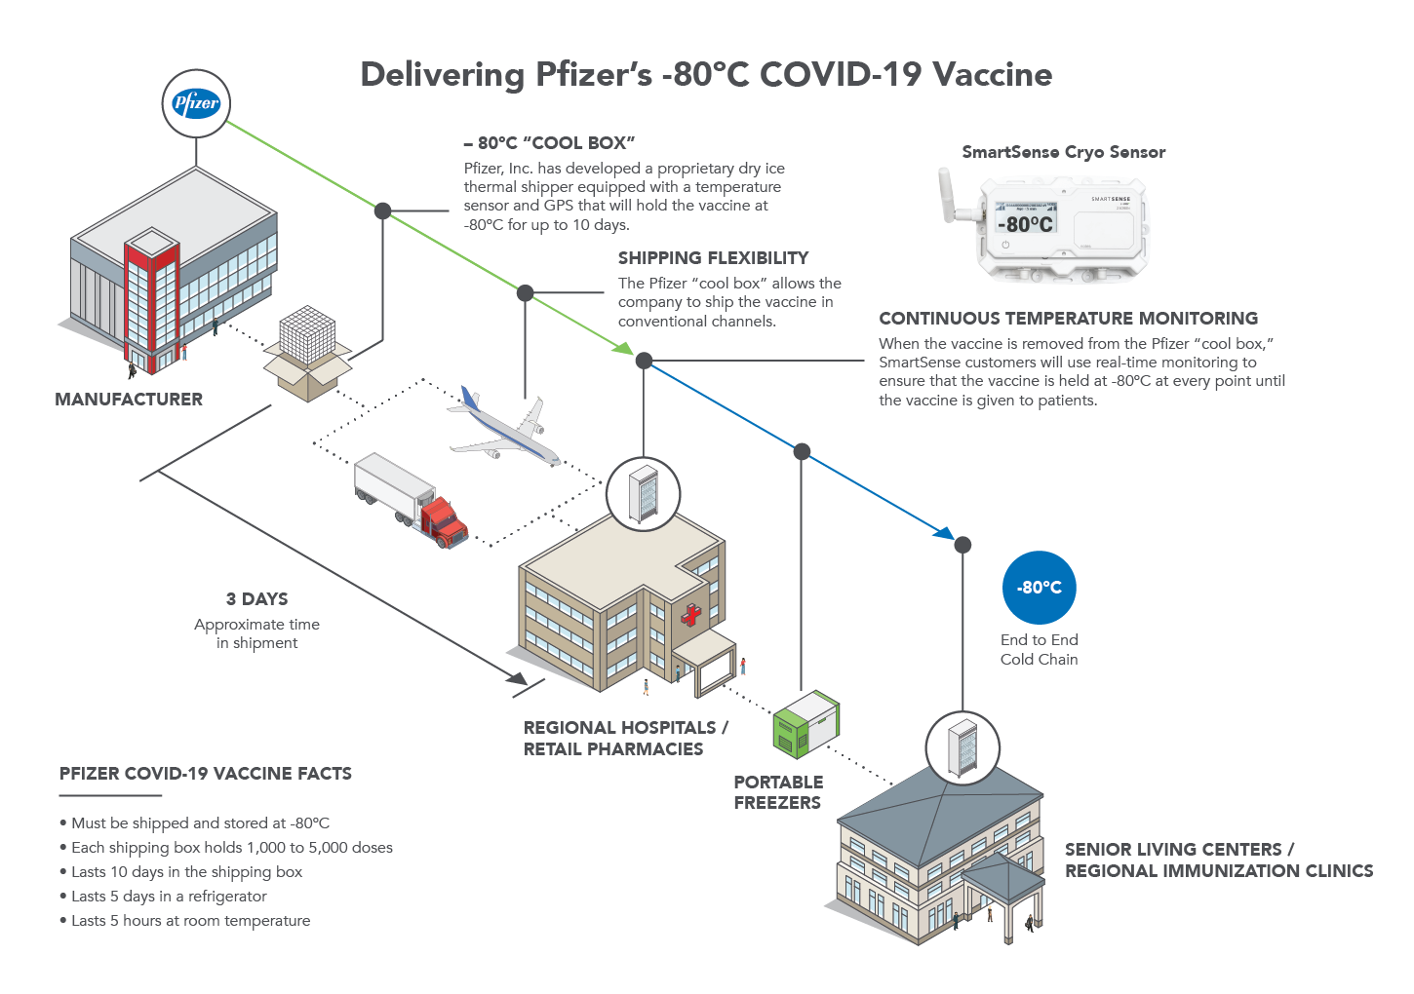
Pfizer’s Cold Chain
Flexible Just-In-Time system
Built-In quality
Poka-yoke
Cold chain leader – quick scalability
Self-reliance
Source: https://blog.smartsense.co/ramping-up-for-nationwide-covid-19-vaccine-distribution-1
Notes:
We will use Pfizer as an exemplifying company that leveraged a lean system to manufacture and distribute hundreds of millions of vaccines.
The Pfizer vaccine is mRNA-based and has to be shipped at very low temperatures. Moderna has an mRNA-based vaccine, too.
Pfizer is a global leader in supply chain logistics and successfully scaled its operations to fit the needs of producing a covid-19 vaccine.
Pfizer’s distribution system is built in a flexible just-in-time system.
The manufacturing process takes 60 days – it is a complicated 19 step process that adds value in each step, barring testing and transportation
Containers have built-in poka-yoke’s that automatically signal when temperatures deviate
Pfizer scaled its operations quickly, spending $700 million to increase capacity
Pfizer is self-reliant and produces lots of materials for the vaccine in-house PLUS it makes its own dry ice. It does not rely on other distributors, either, sustains a JIT delivery system → one-piece flow.

Slide 6
Addressing Problems
Material & Equipment Shortages
- Take over existing production lines
- Funding for capacity expansion
Manufacturing Process Complexity
- Retrofit facilities
- Improve yields
- Management from skilled personnel
Capacity Constraints
- Stakeholder cooperation
Notes:
https://www.lek.com/insights/ei/covid-19-vaccine-manufacturing-challenges-solutions-and-implications-pharma-industry
A lot of manufacturing issues were caused by production bottlenecks. Here are some of the challenges and solutions by companies.

Slide 7





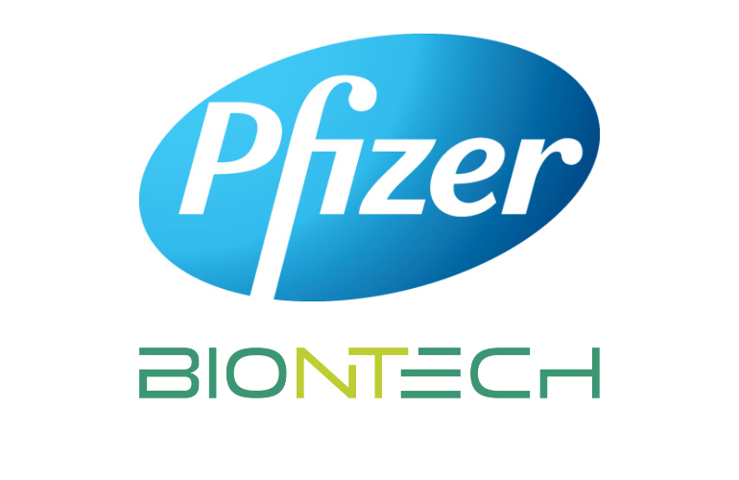

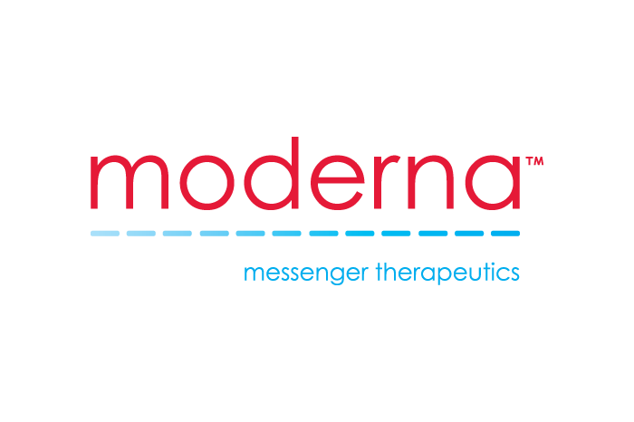
Collaborative Effort- ACTIV
Notes:
Food and Drug Administration, Center for Disease Control, National Institutes of Health, Department of Defense, Biomedical Advanced R&D Authority, Moderna, Pfizer-BioNTech and many, many others that I could not list
ACTIV (Accelerated COVID-19 Therapeutic Interventions and Vaccines.
Rallied around a clear mission – to create a safe vaccine ASAP – and shared information seamlessly.
The high-speed, problem-solving nature of this collaboration is like that of a lean-thinking culture.
Scientists, production teams, distributors, and government officials all had to work together to create a value-stream with as little time-delay as possible.
Nothing was sequential. Manufacturers began scaling up as soon as clinical trials began.
Furthermore, investment in manufacturing and production, which came from government aid and has reached up to $20 billion, has helped bring lots of resources and prepare for high volumes.

Slide 8
Results?

Slide 9
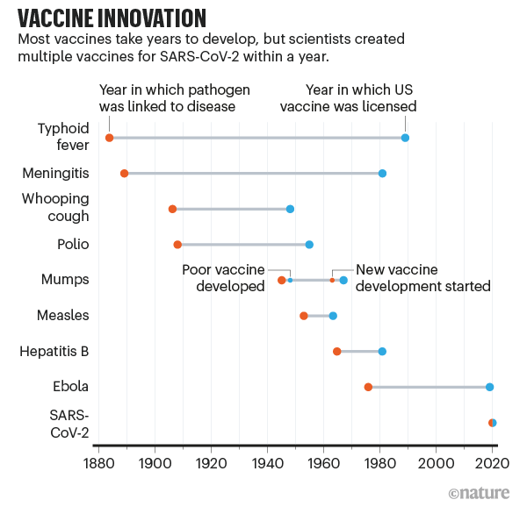
A 5-year minimum to develop, produce, and distribute new vaccines (Sobek II, 2020).
Multiple Covid-19 vaccines developed within a year.
Source: https://www.nature.com/articles/d41586-020-03626-1
Notes:
To make sense of how wild of an operations accomplishment this is, take a look at the average vaccination timeline in the past.
From the identification of the disease to the development of a vaccine it took:
- Typhoid fever: Over 100 years
- Meningitis: a little under 100 years
- Whooping cough: about 40 years
- Polio: about 45 years
- Mumps: an unusable vaccine in ~2-4 years, a usable vaccine in ~4-6 years, for a total of about 20 years
- Measles: a little over 10 years
- Hepatitis B: a little over 15 years
- Ebola: over 30 years
- SARS-CoV-2: <1 year
Typically, it takes a minimum of 5 years to develop, produce, and distribute vaccines.
A lot of this time is dedicated to clinical trials and testing; human testing requires 3 trials.
All in all, the entire process of developing and distributing this vaccine was reduced by 80%.

Slide 10
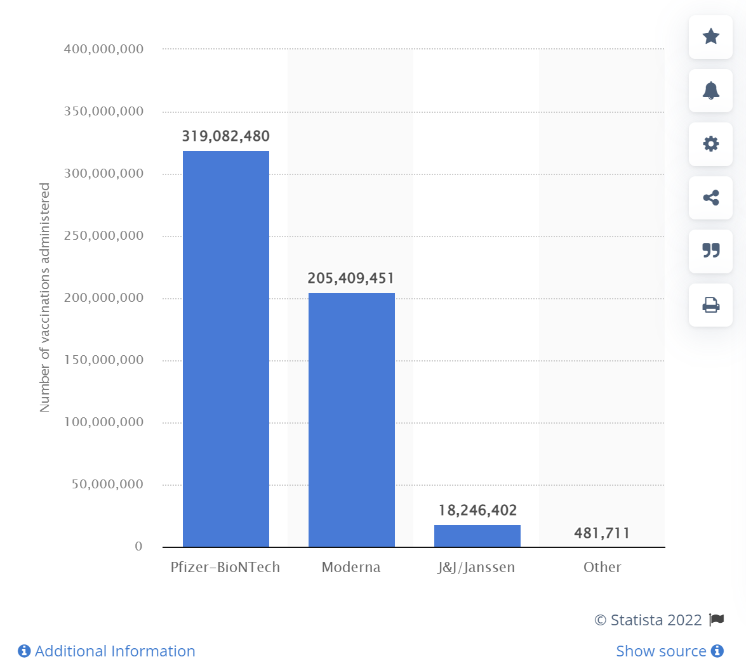
U.S. vaccination numbers by company
Last updated February 6th, 2022.
Total: https://www.statista.com/statistics/1198516/covid-19-vaccinations-administered-us-by-company/
Notes:
320 million vaccine doses by Pfizer-BioNTech
205 million vaccine doses by Moderna
18 million vaccine doses by J&J
Half a million by other companies.
Total of over 540 million vaccine doses administered so far.

Slide 11
Limitations
Small time frame and large volumes causing production problems for Moderna and AstraZeneca.
Limited to date range from Dec 2019 → April 2021
How will variants affect operational initiatives?
Limited to U.S. manufacturers and companies – other countries may have different strategies and resources available.

Slide 12
References
Assistant Secretary for Public Affairs (ASPA). “Covid-19 Vaccines.” HHS.gov, 2 Feb. 2022, https://www.hhs.gov/coronavirus/covid-19-vaccines/index.html.
Ball, Philip. “The Lightning-Fast Quest for Covid Vaccines - and What It Means for Other Diseases.” Nature News, Nature Publishing Group, 18 Dec. 2020, https://www.nature.com/articles/d41586-020-03626-1.
Barone, Emily. “How Operation Warp Speed Vaccine Spending Compares.” Time, Time, 14 Dec. 2020, https://time.com/5921360/operation-warp-speed-vaccine-spending/.
Corey, Lawrence, et al. “A Strategic Approach to COVID-19 Vaccine R&D.” Science, Science, 11 May 2020, https://www.science.org/doi/10.1126/science.abc5312.
Cott, Emma, et al. “How Pfizer Makes Its Covid-19 Vaccine.” The New York Times, The New York Times, 28 Apr. 2021, https://www.nytimes.com/interactive/2021/health/pfizer-coronavirus-vaccine.html?auth=login-google.
“Covid-19 Vaccine R&D Funding.” Knowledge Portal, 8 July 2021, https://www.knowledgeportalia.org/covid19-r-d-funding#:~:text=The%20public%20sector%20and%20CEPI,99.4%25%20(APAs%20included).
Frank, Richard G., et al. “It Was the Government That Produced COVID-19 Vaccine Success: Health Affairs Forefront.” Health Affairs, 14 May 2021, https://www.healthaffairs.org/do/10.1377/forefront.20210512.191448/#:~:text=Most%20recently%20the%20Congressional%20Budget,on%20COVID%2D19%20vaccine%20development.
Garland, Max. “How Pfizer Transformed Its Supply Chain to Deliver Vaccines at Lightspeed.” Supply Chain Dive, 21 Sept. 2021, https://www.supplychaindive.com/news/pfizer-jim-cafone-covid-vaccine-manufacturing-distribution-cscmp/606867/.
“Manufacturing and Distributing the COVID-19 Vaccine.” Pfizer, https://www.pfizer.com/science/coronavirus/vaccine/manufacturing-and-distribution.
SmartSense. “Ramping up for Nationwide COVID-19 Vaccine Distribution.” Connected Insights Blog, 30 Nov. 2020, https://blog.smartsense.co/ramping-up-for-nationwide-covid-19-vaccine-distribution-1.
Sobek II, Durward K. “Coronavirus Vaccine: Lean Development Principles in Action.” LPPDE, 15 Jan. 2021, https://lppde.org/coronavirus-vaccine-lean-development-principles-in-action/.
“Vaccine Research & Development.” Johns Hopkins Coronavirus Resource Center, https://coronavirus.jhu.edu/vaccines/timeline.
Wallace-Wells, David. “We Had the Vaccine the Whole Time.” Intelligencer, Intelligencer, 7 Dec. 2020, https://nymag.com/intelligencer/2020/12/moderna-covid-19-vaccine-design.html.
Zayko, Matt. “Lean and the Global Covid-19 Vaccine Race.” Planet Lean, 18 Jan. 2021, https://planet-lean.com/lean-process-development-vaccine/.

